Slide 1
DI Financial Overview
Q2 (July-September 2025)

Slide 2
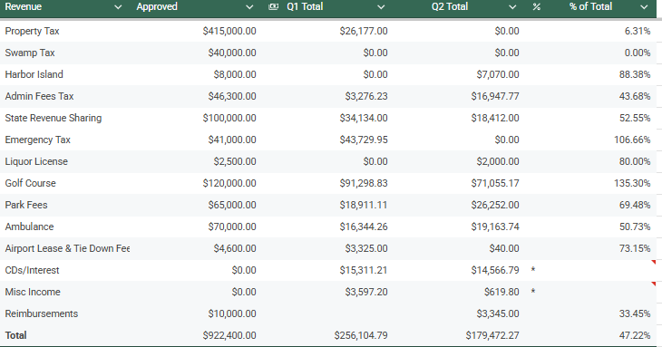

Slide 3
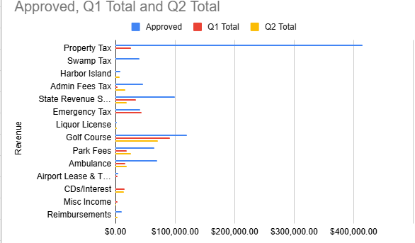

Slide 4
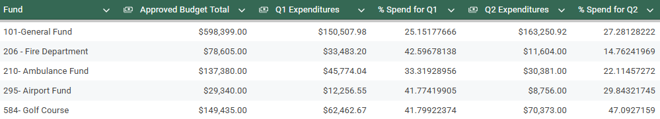
Expenditures
Notes:
General Fund (27.28%) – Expenditures are tracking appropriately and support the Township’s broad operational needs.

Slide 5
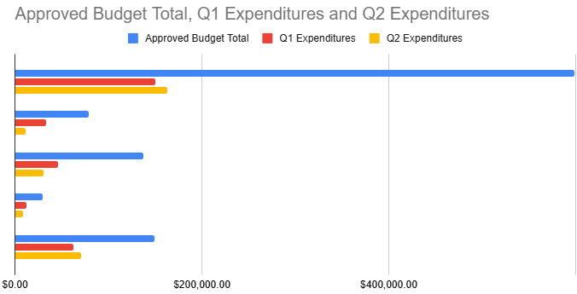
General Fund
Fire
Ambulance
Airport
Golf Course

Slide 6
Q2 Summary
Township finances stable and on track
Revenues consistent with seasonal expectations
Half year spend ahead for General Fund, Airport, Golf Course, and Fire Department
Strong performance in Golf Course and Park revenues
Anticipated adjustments for NEMSA beginning October
Ambulance behind spend projections
Notes:
Summer – Dump Days, Fireworks, Park spend,

Slide 7
Q2 Projections vs. Actual
(July – September 2025)

Slide 8
Q2 Expenditure Projections
General Fund: 28% spend
Fire Dept: 16% spend
Airport: 34% spend
Golf Course: 47% spend
Ambulance: 25% Spend
Actual 27.28%
Actual 14.7%
Actual 29%
Actual 47%
Actual 22%

Slide 9
First Half Expenditure Projection
General Fund 53%
Fire Department: 58.5%
Airport: 76%
Golf Course: 89%
Actual: 52.3%
Actual: 57.4%
Actual 71.6%
Actual: 88.9%

Slide 10
Q3 Projections
(October – December 2025)

Slide 11
Q3 Expenditure Projections
General Fund: 20% spend
Fire Dept: 12% spend
Airport: 5% spend
Golf Course: 3% spend
Ambulance: 25% Spend

Slide 12
Golf Course Highlights
(April– September 2025)

Slide 13
Golf Course Revenue Sources
Description | Budgeted Revenue | Activity (9/30/2025)
Merch Sales | $7,200 | $14,967
Greens Fees | $42,000 | $50,148
Membership | $36,000 | $45,643
Golf Cart Fees | $34,800 | $27,455.50
Facility Rental | $0.00 | $500.00
 | $120,000 | $138,713.5

Slide 14
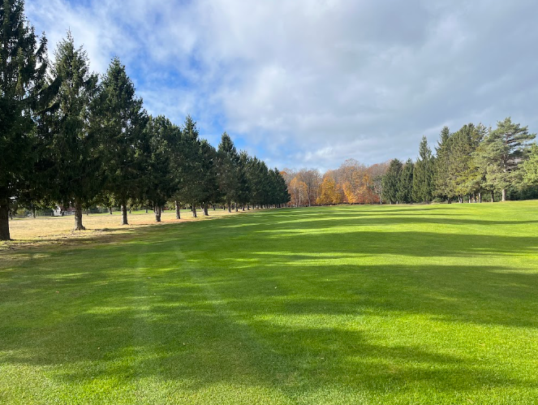
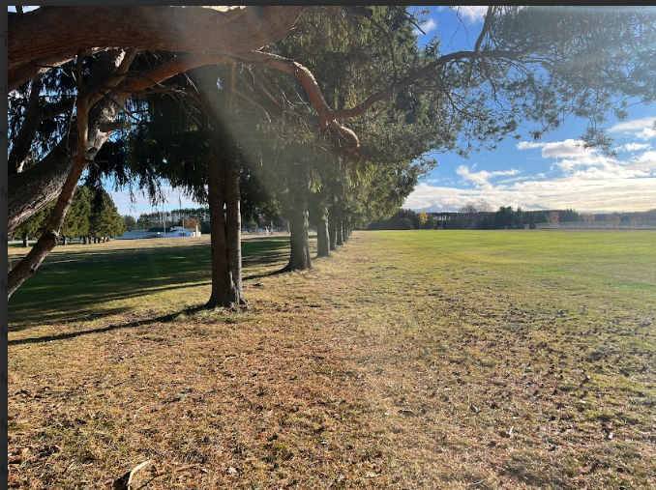
Course Updates

Slide 15
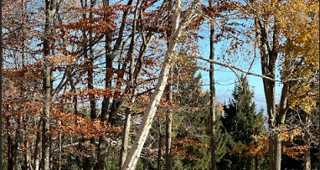
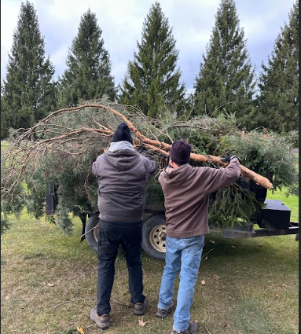
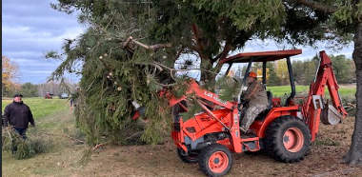

Slide 16
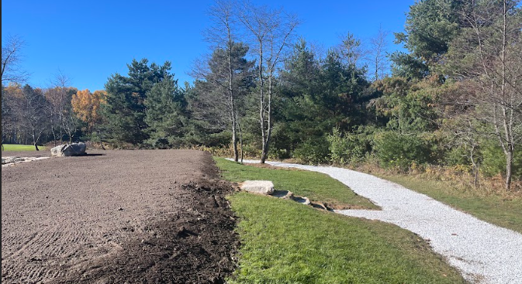
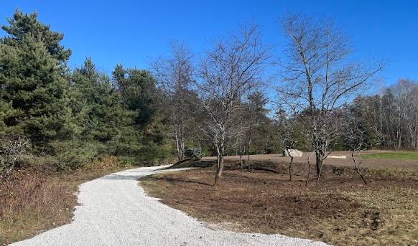
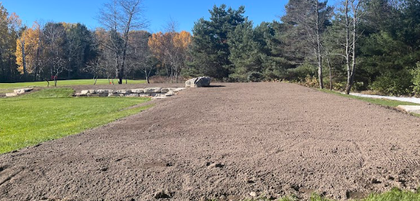
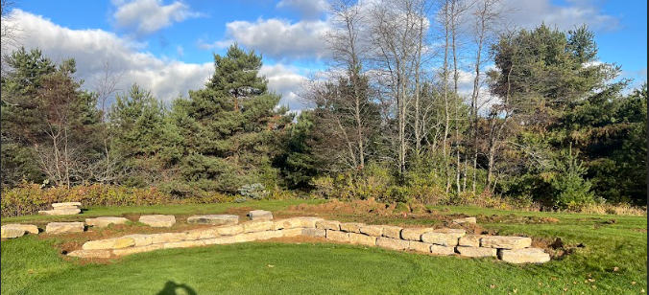

Slide 17
Park Highlights
(April– September 2025)

Slide 18
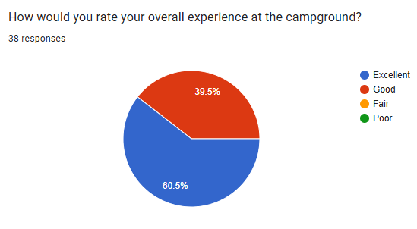
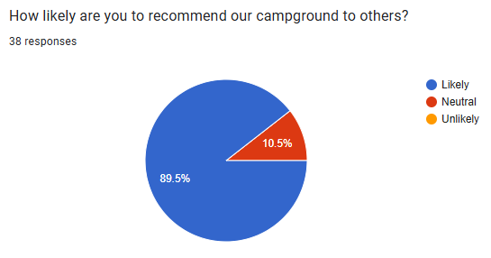
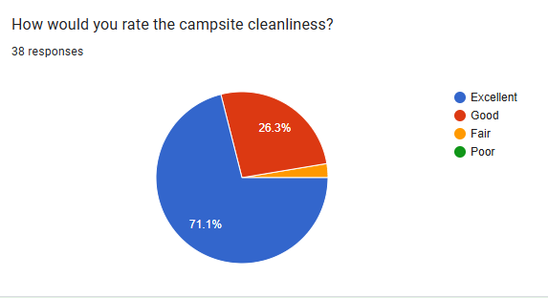
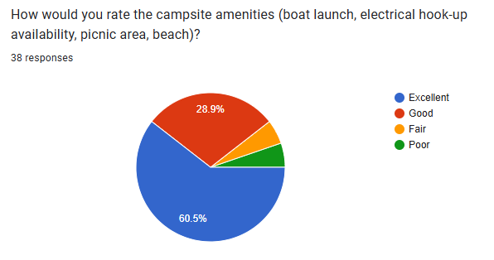
Survey Responses

Slide 19
What’s Next?
Year-round booking (available now)
Maintenance priorities based on patron feedback
Finalize electrical work

